Slide 1
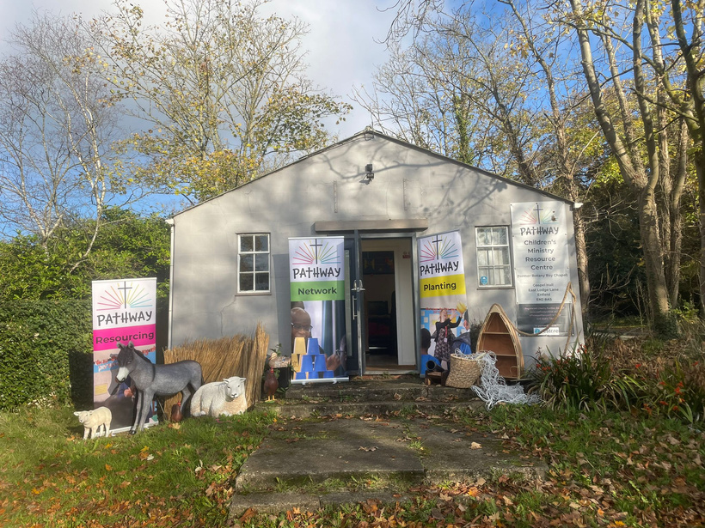

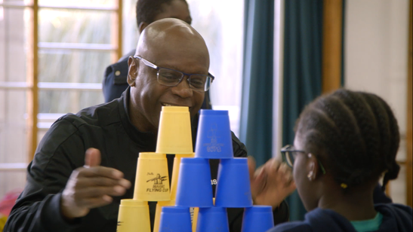
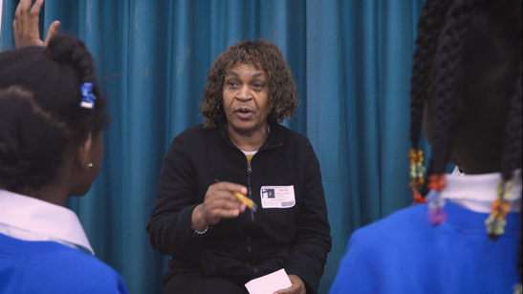
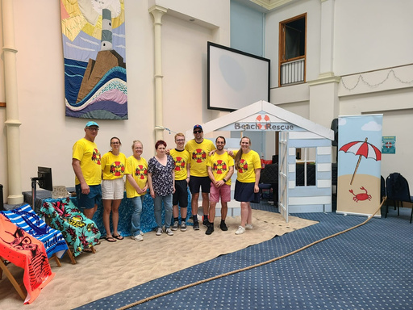
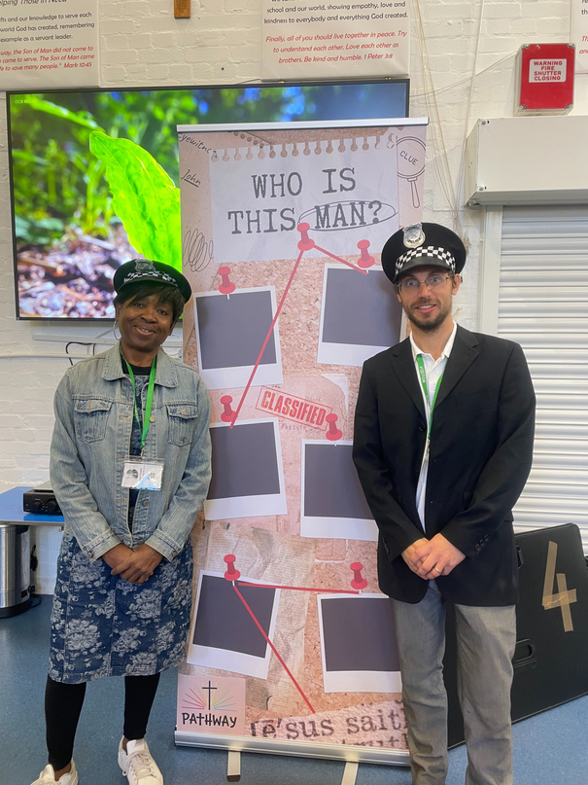
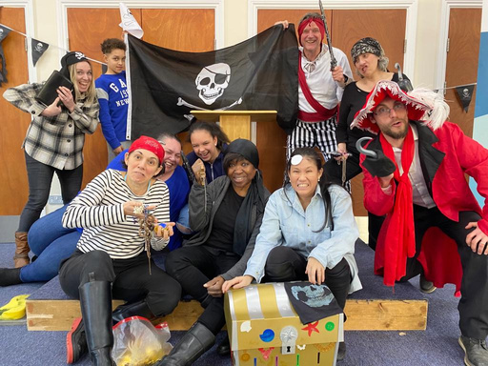
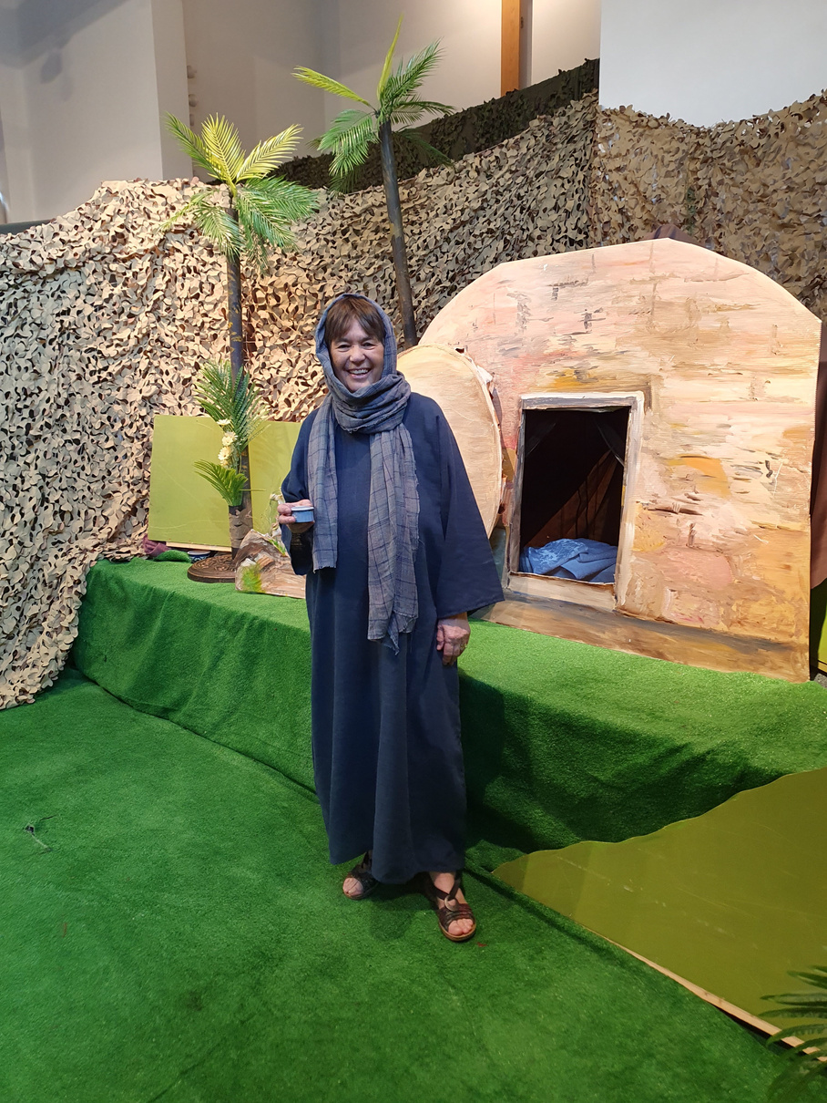
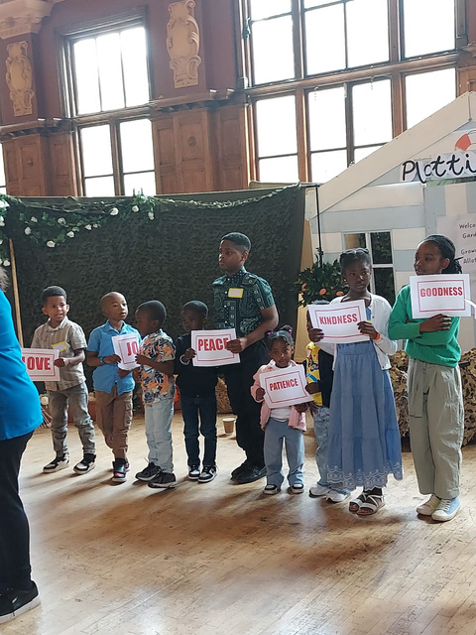
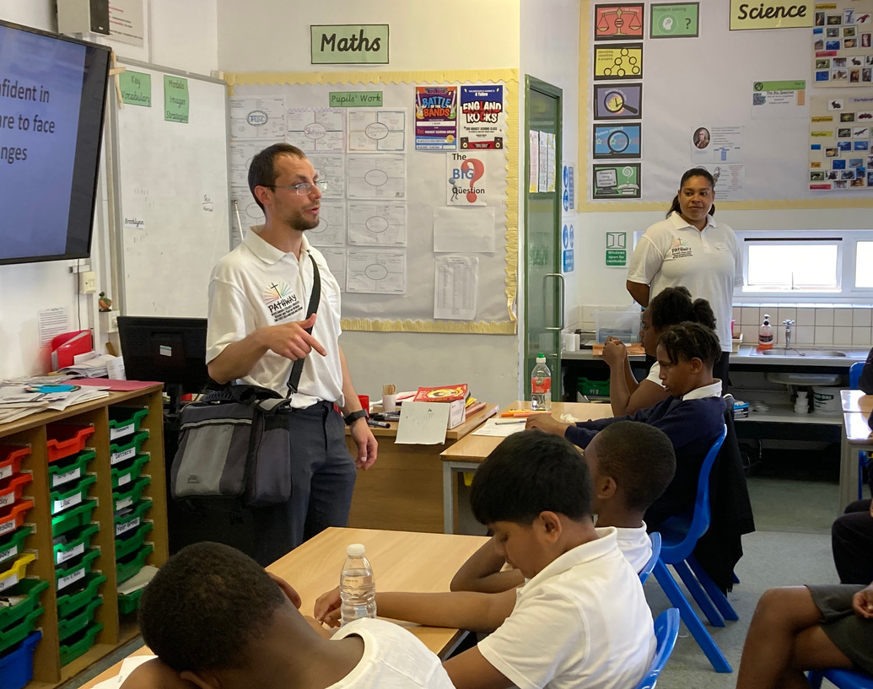
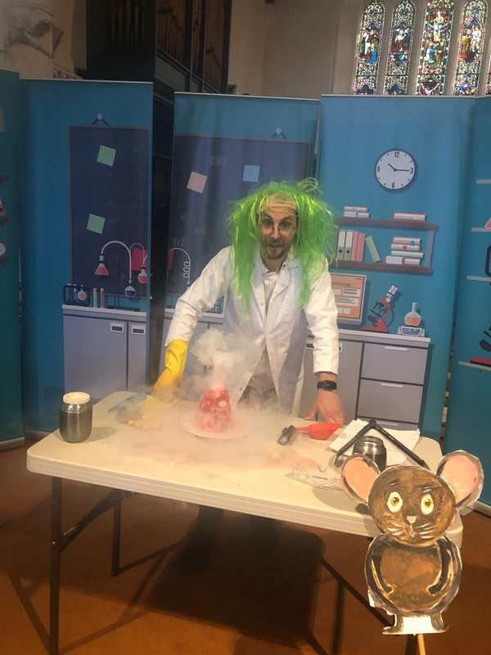
Charity number:
1210452
4+ Lunch clubs
Prop hire
Clubs
9+ After school
We exist to equip churches in North London to reach children in their communities with the gospel
40+ Assemblies
Holiday clubs
Workshops
Events
Schools work
Church retreats
Fun Days
Christmas & Easter Experiences
Light Parties

Slide 2

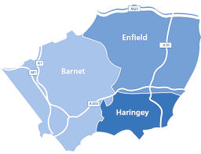
Since 2023, Grant Funding & your generous support has enabled us to grow our staff team and expand the ministry.
I
Next Steps
Here are just a few of the ways that your support has enabled the work to grow rapidly
PATHWAY 2026 APPEAL
5 clubs expanded to 13
Christmas Experience expanded from 3 to 5+ venues (2000+ children in 2025)
Easter Experience started & expanded
Church holiday clubs, Light Parties, Fun Days & Church retreats
New prop hire facility
New schools receiving workshops & assemblies
10k+ children hearing assemblies
In development
Pre-2023
4
Post-2023
5
2
9
10
6
3
1
11
8
12
7
13
Pathway supported clubs map

Slide 3

I
Next Steps
PATHWAY 2026 APPEAL
I found faith through Pathway
Image posed
by a model

Slide 4
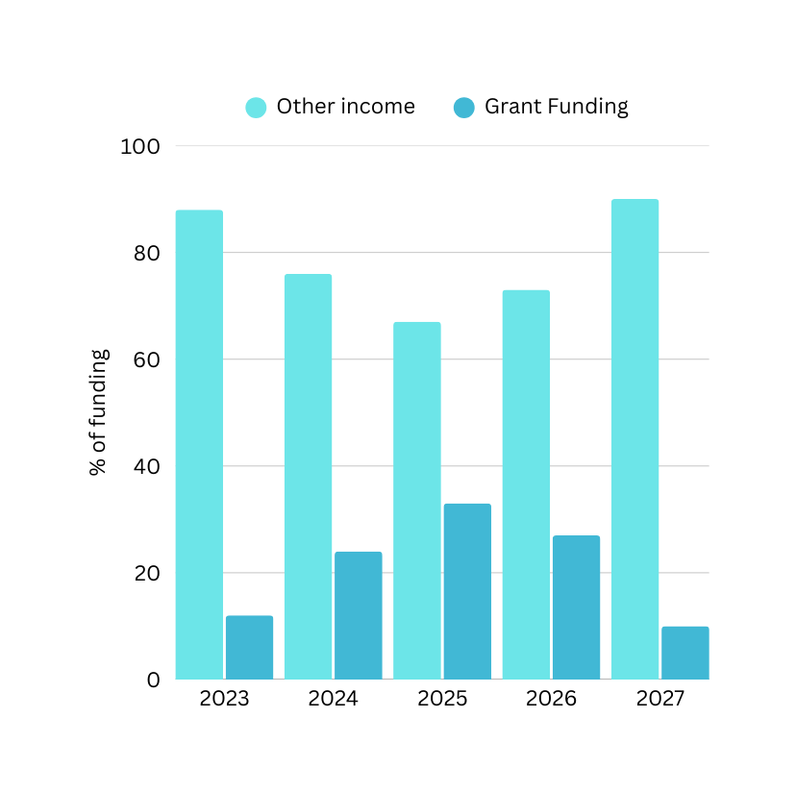




The impact is clear, but the grant funding is coming to an end, so will you help us sustain this into the future?
t
Next Steps
From July 2026 we need to raise an extra £15k/annum through regular giving
PATHWAY 2026 APPEAL
Every gift helps Pathway equip churches like yours to share Jesus with children in your community
£££
££
£
t
Can you help us by giving a monthly/quarterly/annual donation towards this target?
Notes:
Hi Kara

Slide 5
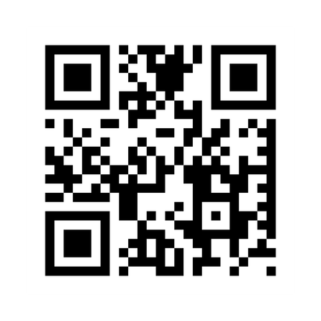
Partner with us in the work
Partner with us in prayer
Partner with us in financial support
Pathway website
www.pathwayonline.co.uk
@pathwayforschools
Let’s keep in touch

Slide 6
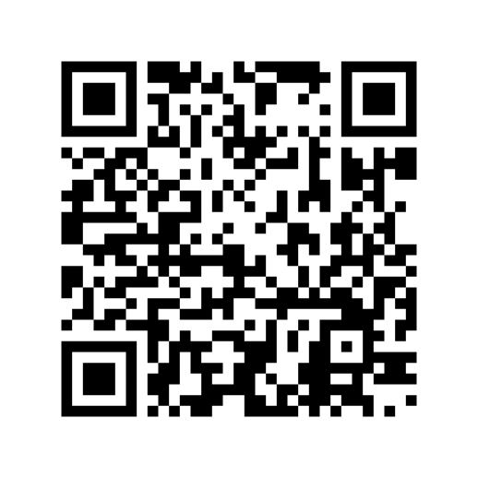

NEXT STEPS 2026
APPEAL RESPONSE FORM
I would like to join in praying for Pathway. Please sign me up to your mailing list to receive newsletters, event invitations and other relevant communications.
[Please include your email or postal details below]
GIFT AID MY DONATION (Individual donors only)
Your Details:
*Title
*Forename(s)
*Surname
*Address
*Postcode
Phone
Email
Mobile
*This information is required by HMRC for Gift Aid.
Gift Aid Declaration:
Boost your donation by 25p of Gift Aid for every £1 you donate: Gift Aid is reclaimed by Pathway from the tax you pay for the current tax year. In order to Gift Aid your donation, please read and sign the following declaration.
Please treat as Gift Aid donations all qualifying gifts of money made from the date of this declaration and in the past four years.
I am a UK taxpayer and understand that if I pay less Income Tax and/or Capital Gains Tax than the amount of Gift Aid claimed on all my donations in that tax year, it is my responsibility to pay any difference. I will notify Pathway if I want to cancel this declaration, change my name or home address, or no longer pay sufficient qualifying tax on my income and/or capital gains.
*Signed _____________________________________________
*Date _____________________________________________
General Data Protection Regulation (GDPR) 2018
This information will be used for processing your donation and Gift Aid reclaims from the HMRC only. We will need to store this data on our secured system for these purposes. We will not use this data for other purposes without your permission.
Security
We are committed to ensuring that your information is secure. We will never share any of your information with anyone outside Pathway unless we have your permission or are required by law to do so. You may request details of personal information which we hold about you under the General Data Protection Regulation 2018. If you ask us to delete your information we will delete it permanently and completely from our records.
If you believe that any information we are holding on you is incorrect or incomplete, please write to or email us as soon as possible, at the above address. We will promptly correct any information found to be incorrect.
Declaration
Please read the consent below, sign and date the form at the bottom and return it to us.
My consent is valid from the date signed here until the next update carried out by Pathway, unless I write or email to inform you otherwise.
Signed: _____________________________________________
Date: _______________________________________________
I would like to join in paying for Pathway.
by making regular donations of:
£___________ monthly quarterly other ___________ (please specify)
by making a one-off donation of:
£___________
I will make payment:
In person by cash or card payment (contact us)
By cheque (made payable to Pathway) to the address below
Next Steps
By BACS transfer (Reference - 2026 Appeal)
Acc no. 72311924 Sort code 60-15-20
https://www.stewardship.org.uk/partners/pathway
(please mark your donation ‘Next steps 2026’
PATHWAY 2026 APPEAL
Via CAF (Reference - 2026 Appeal)
By standing order (Please contact your bank)
If you are a UK taxpayer, please consider using Gift Aid to increase your donation to Pathway by 25% at no extra cost to you. See the form on the next page.
If you wish your donation to be anonymous, please leave the section below blank and use a separate form to sign up for our newsletter.
VIA STEWARDSHIP
NAME:
ADDRESS:
EMAIL:
PHONE NUMBER:
We will only use this information to contact you as indicated above.
Please return this form to:
Gospel Hall, East Lodge Lane, Enfield, EN2 8AS or office@pathwayonline.co.uk
Telephone enquires to 0208 343 7584
Visit our website: www.pathwayonline.co.uk
Follow us on Facebook, Instagram or Youtube: @pathwayforschools
REGISTERED CHARITY NUMBER 1210452

